Slide 1
Design and Analysis of Algorithms
20CSC12
A Sangeetha, Assistant Professor, CSE, CBIT

Slide 2
Course Objectives
Provide an introduction to formalisms to understand, analyze and denote time complexities of algorithms.
Introduce the different algorithmic approaches for problem solving through numerous example problems.
Provide some theoretical grounding in terms of finding the lower bounds of algorithms and the NP-completeness.

Slide 3
Course Outcomes
Identify and apply asymptotic notations to measure the performance of algorithms.
Describe the algorithmic design techniques of divide and conquer, greedy, dynamic programming,
backtracking and branch and bound to solve problems.
3. Apply suitable algorithmic design techniques to solve problems to get optimal solution.
4. Analyze the performance of algorithmic design techniques.
5. Evaluate the efficiency of alternative solutions derived for a problem by applying various algorithmic
design techniques.
6. Formulate approximate solutions to NP problem.

Slide 4
Resources
Text Books:
Thomas H Cormen, Charles E Lieserson, Ronald L Rivest and Clifford Stein, “Introduction to Algorithms”, MIT Press/McGraw-Hill, 3rd Edition, 2009.
E. Horowitz, sartajsahni and sanguthevarRajasekaran, “Fundamentals of Computer Algorithms”, Universities Press, 2007.
Suggested Reading:
Michael T Goodrich and Roberto Tamassia, “Algorithm Design: Foundations, Analysis”, and Internet Examples, Wiley Second Edition.
Online Resources:
https://nptel.ac.in/courses/106101060/

Slide 5
Unit - 1
Introduction
Characteristics of algorithm

Slide 6
Why Algorithm?
Problem
Algorithm
Program
Computer

Slide 7
Algorithm
Definition
An algorithm is a finite set of instructions that accomplishes a particular task.
Characteristics of Algorithm
  input
  output
  definiteness
  finiteness
  effectiveness
CHAPTER 1

Slide 8
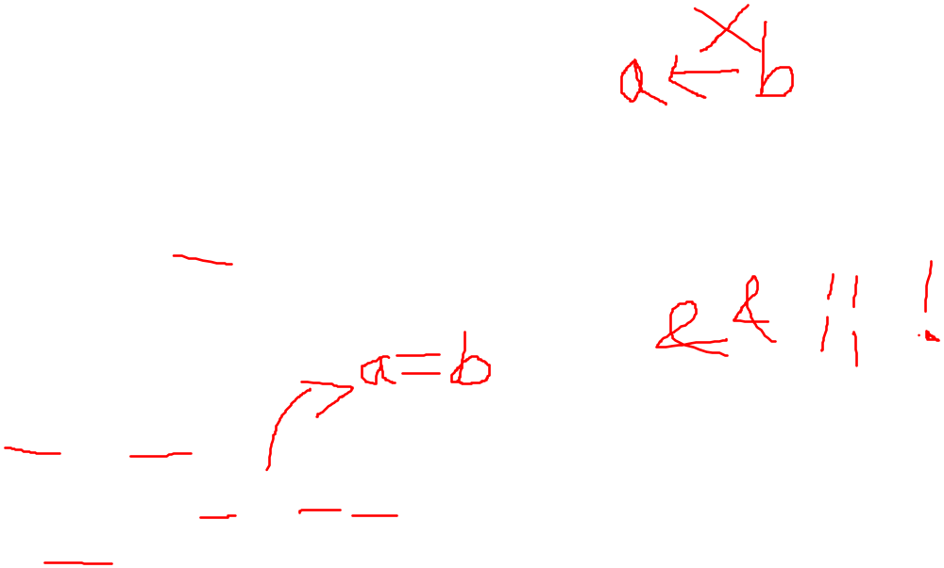

How to write algorithm?
Pseudocode conventions
Comments //
Blocks { }
Identifier
Assignment
<variable>:= <expression>
Boolean
true and false
Logical
and or not
Relational
Arrays [ ]

Slide 9
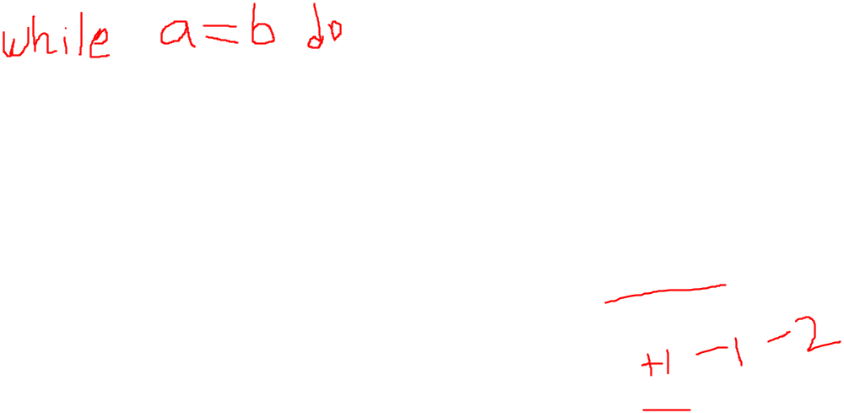
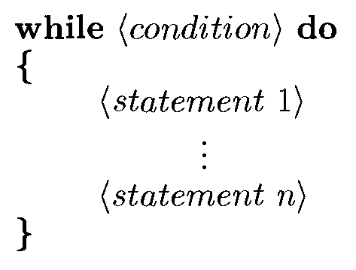
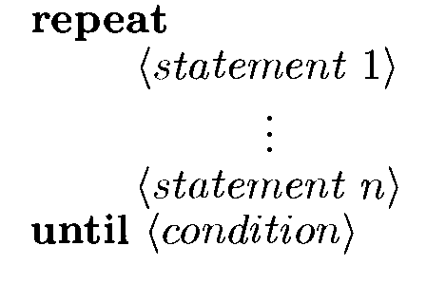
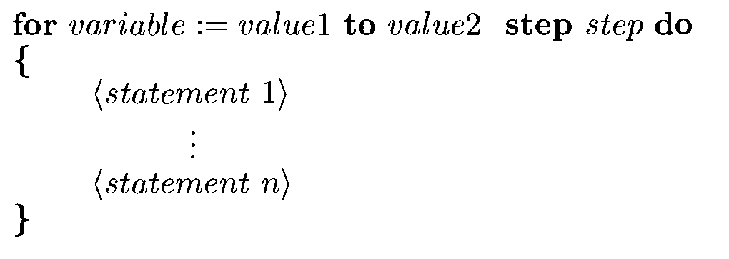
Loops

Slide 10

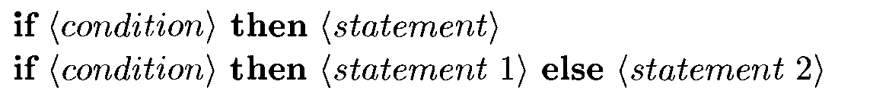
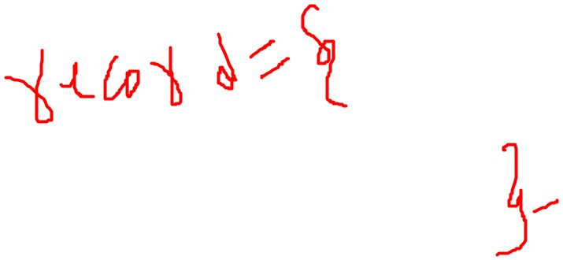
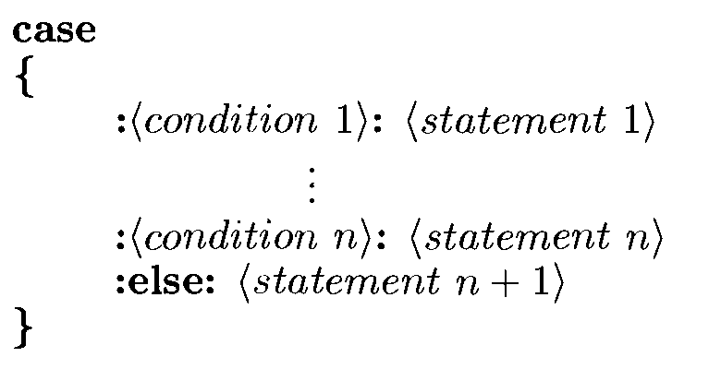
Conditional Statements

Slide 11

Input: read
Output: write
Heading:

Slide 12
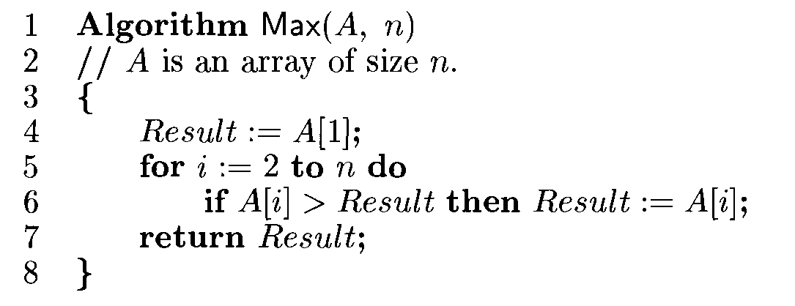
Find Maximum element in an Array

Slide 13
Factorial of a number using Recursion
1 Algorithm fact(n)
2 //Factorial of number n
3 {
4 if n=1 then return 1;
5 else return n*fact(n-1);
6 }

Slide 14
Examples
Write algorithm for the following
Sum of first n natural numbers
Fibonacci series using recursion
Selection sort

